Slide 1
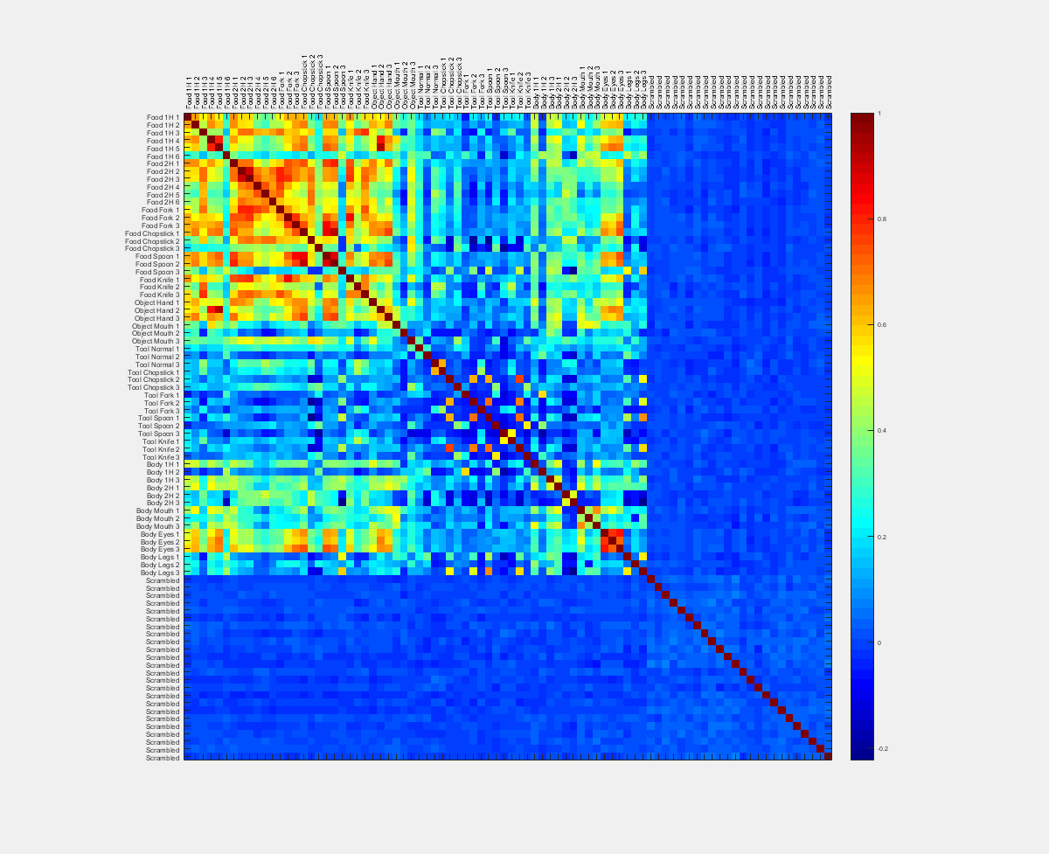
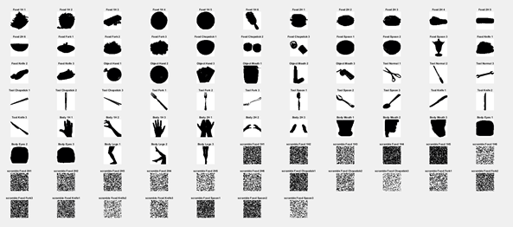
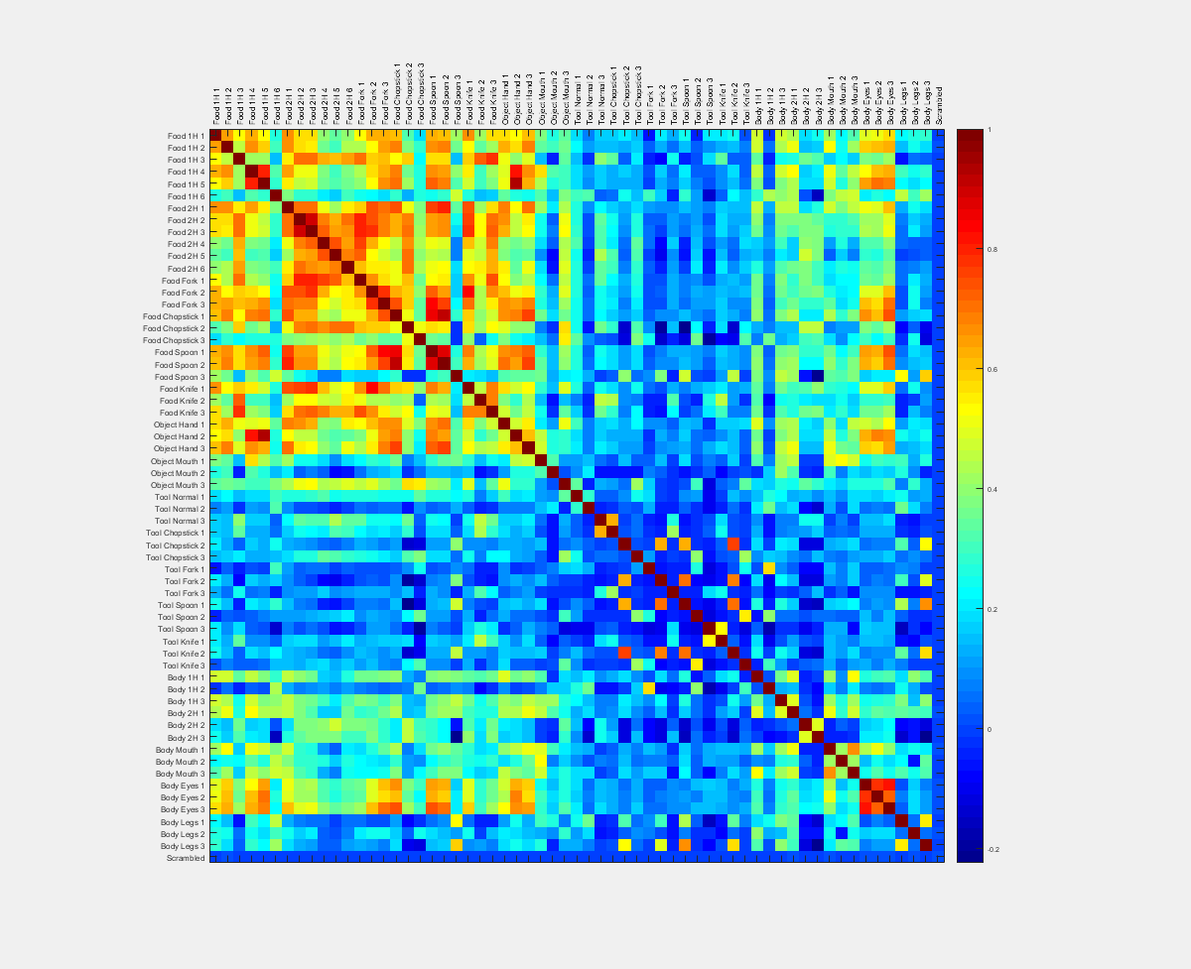
Silhouette
Convert to binary (foreground vs background)
Transform width-by-height binary matrices to 1-by-N arrays
Calculate correlation (Spearman) between each pair of arrays

Slide 2

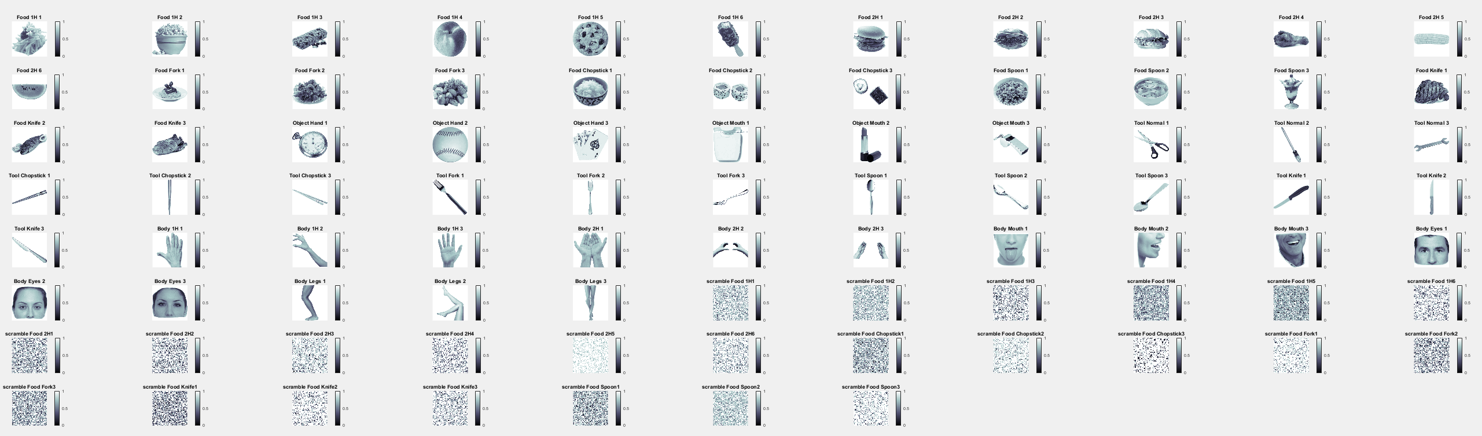
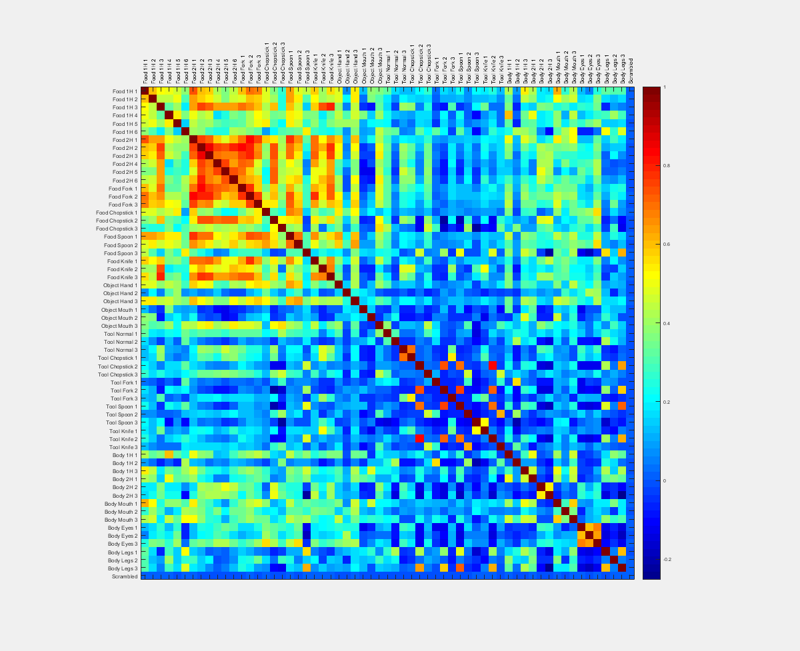
Luminance
Convert to approx. pixel luminance = (0.299 x red²) + (0.587 x green²) + (0.114 x blue²)
Transform width-by-height luminance matrices to 1-by-N arrays
Calculate correlation (Spearman) between each pair of arrays

Slide 3
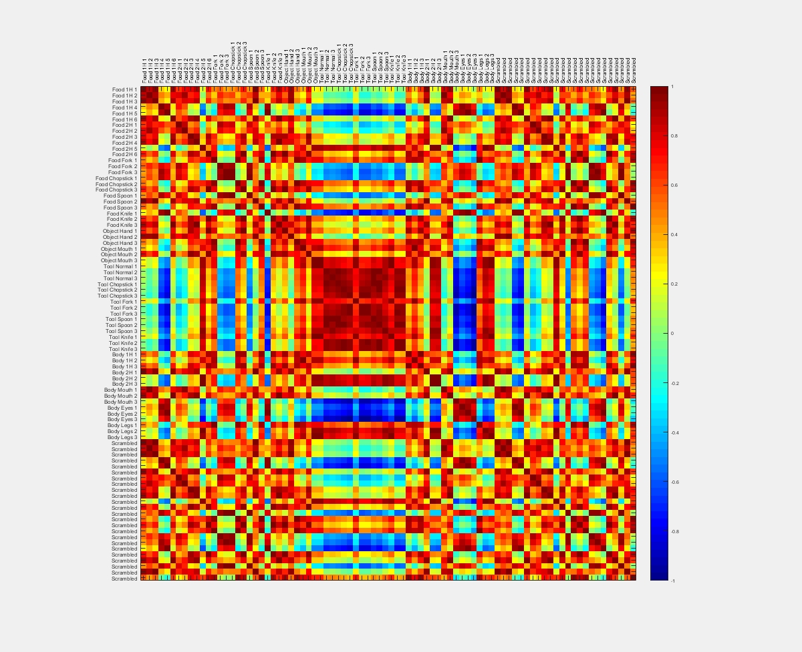
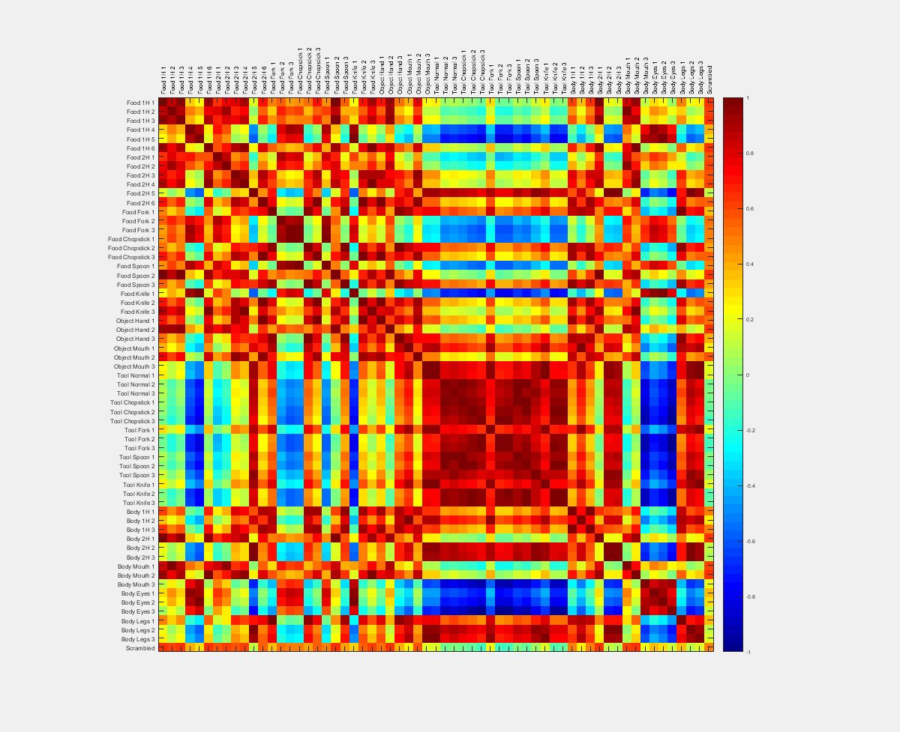
Mean Luminance (All)
Convert to approx. pixel luminance = (0.299 x red²) + (0.587 x green²) + (0.114 x blue²)
For ach image, calculate mean luminance across all pixels (1 value per image)
Includes white background
Compute distance matrix
Invert for similarity

Slide 4
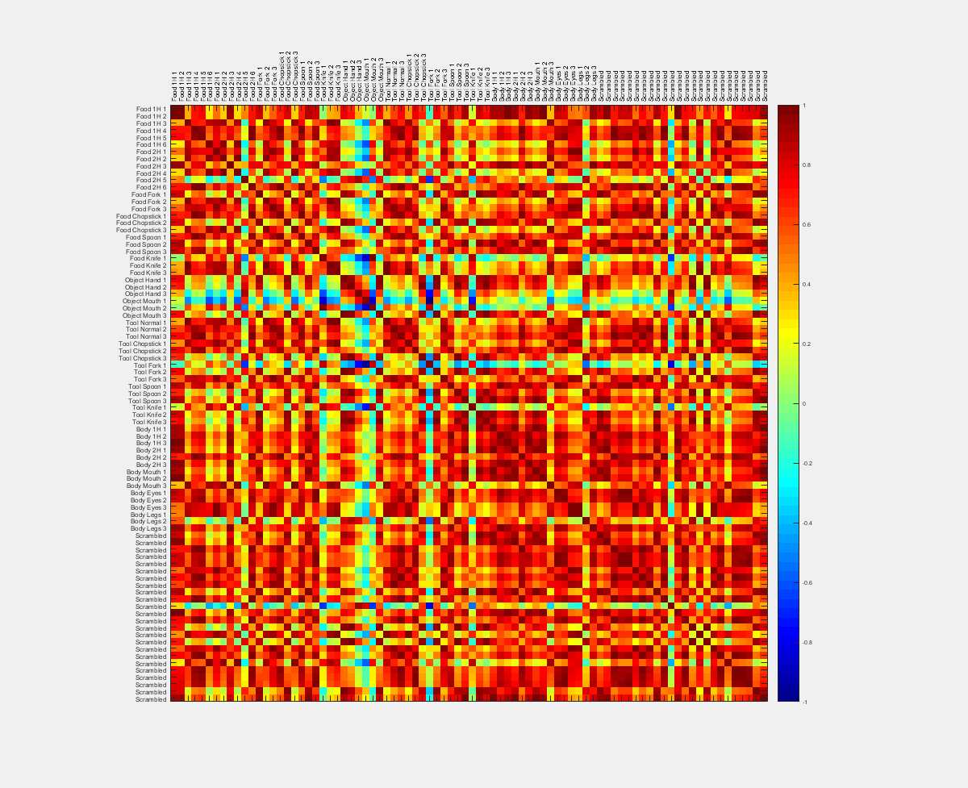
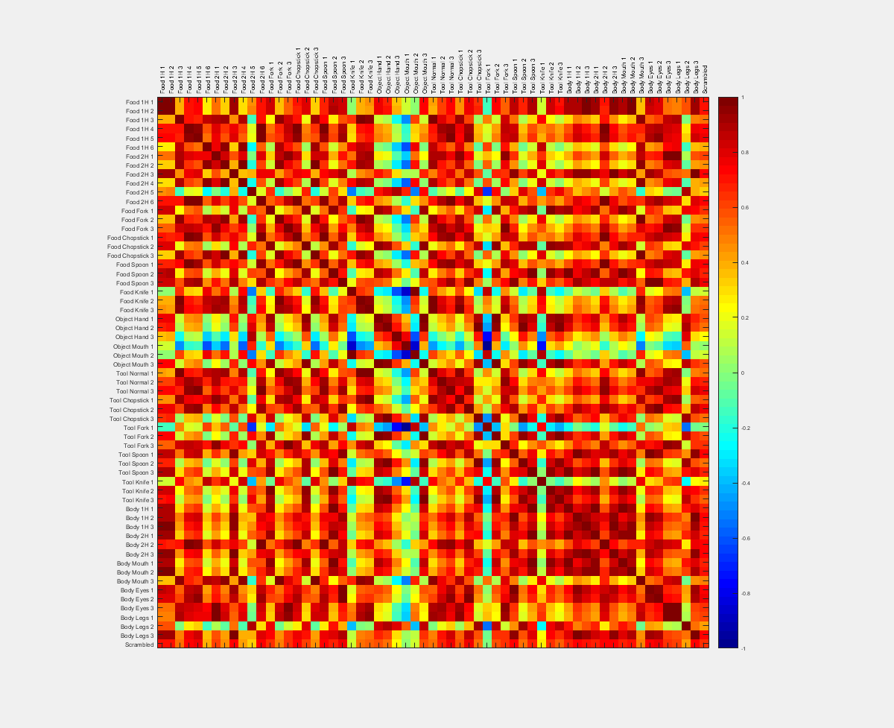
Mean Luminance (Foreground)
Convert to approx. pixel luminance = (0.299 x red²) + (0.587 x green²) + (0.114 x blue²)
For ach image, calculate mean luminance across all foreground pixels (1 value per image)
Compute distance matrix
Invert for similarity

Slide 5
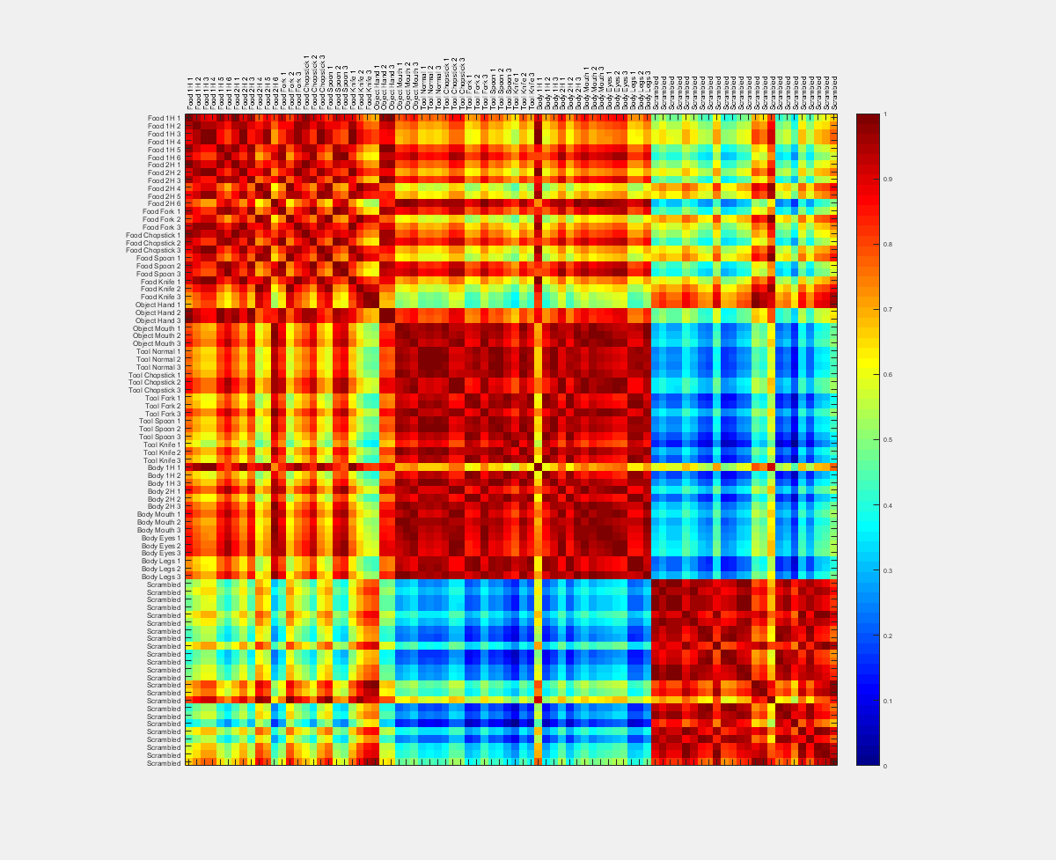
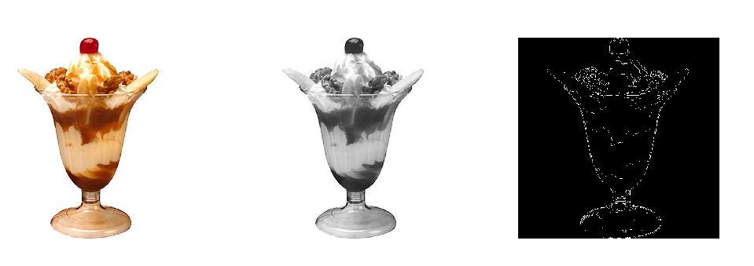
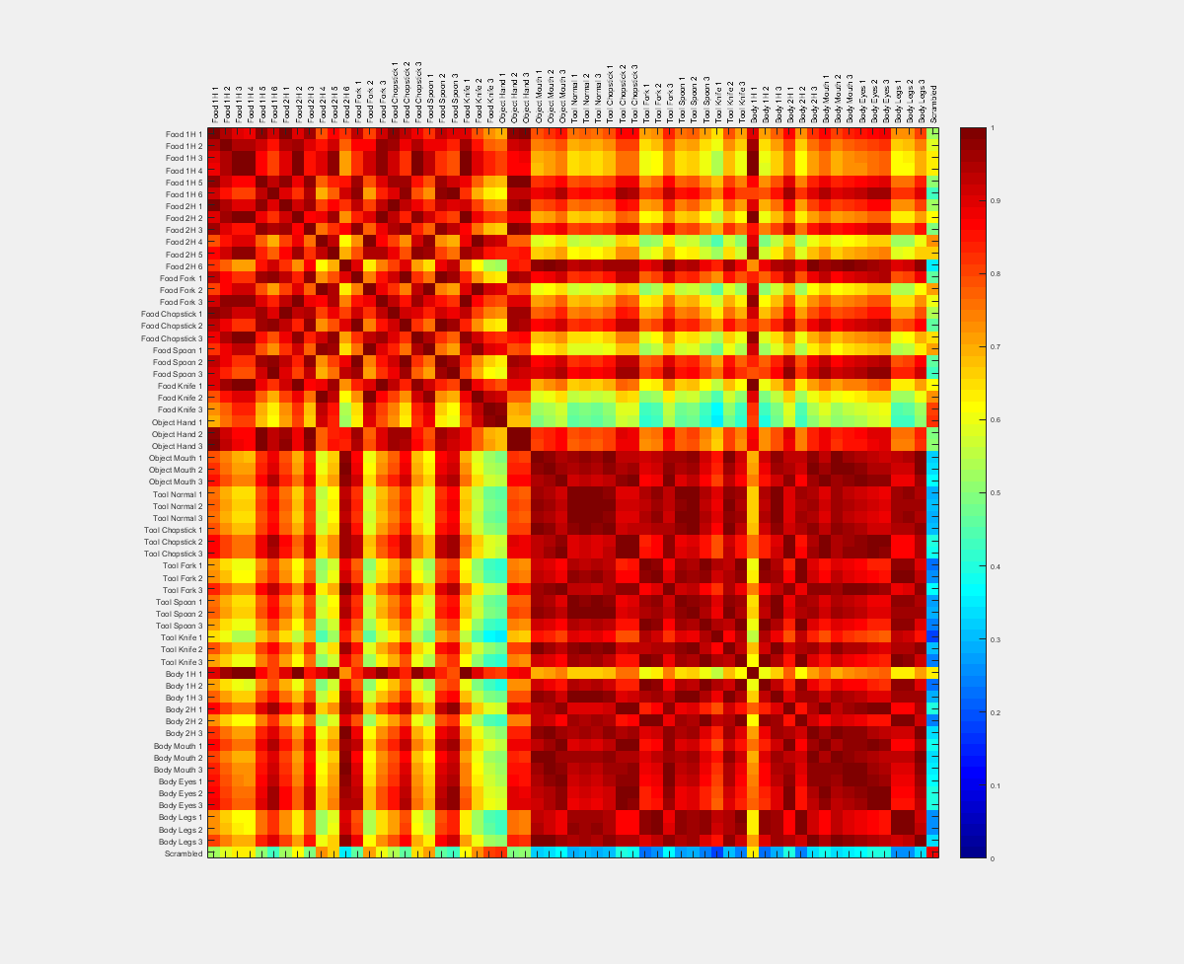
EdgeCount
Use edge detection on each image
Can select between sobel, prewitt, roberts, log, zerocross, canny, or approxcanny
Above used prewitt
Most methods require that the image be converted to grayscale first
Used fast approx. luminance = (0.299 x red) + (0.587 x green) + (0.114 x blue)
Count edge pixels (white pixels in the image image), yields 1 value per image
Compute distance matrix
Invert for similarity

Slide 6
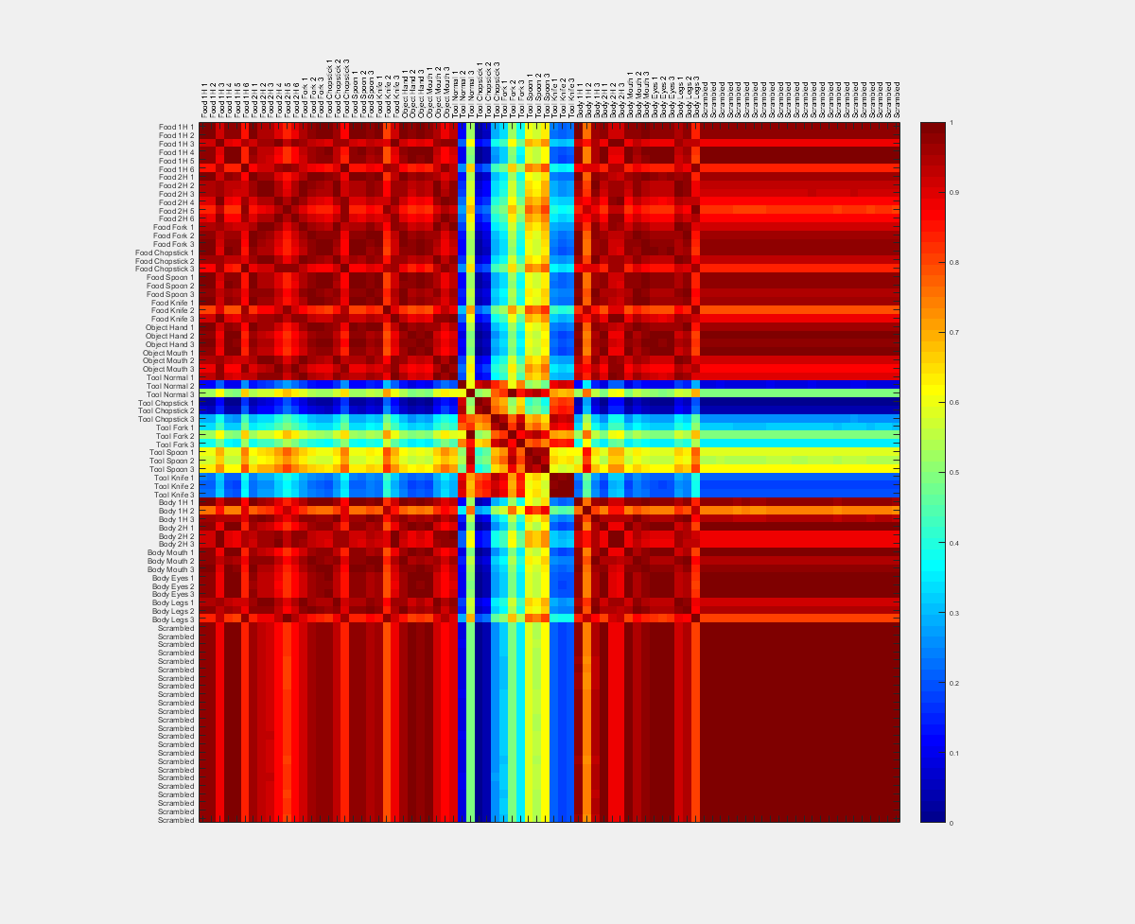
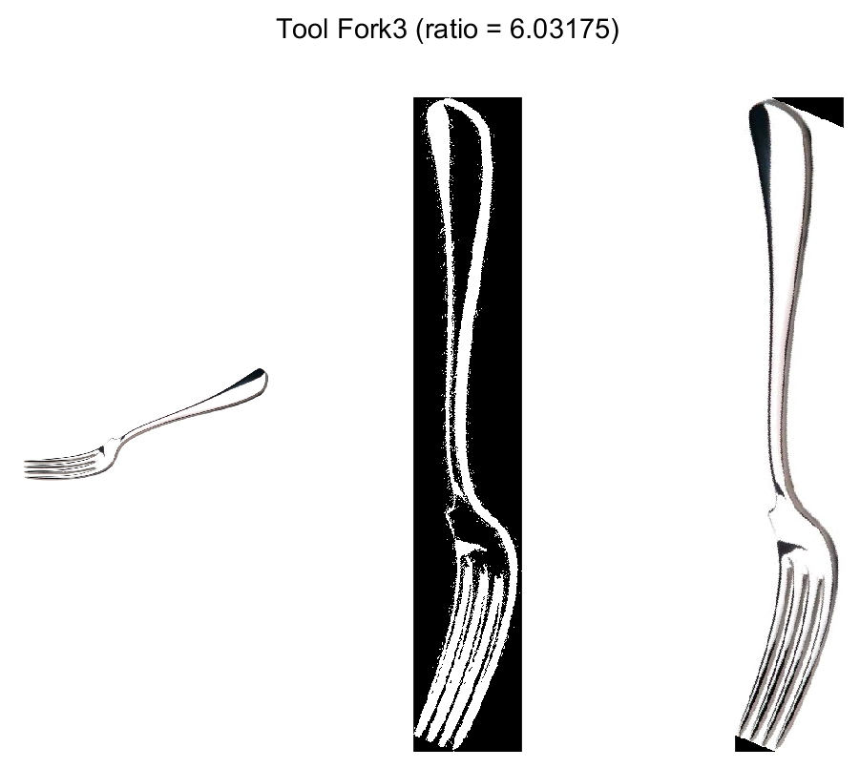
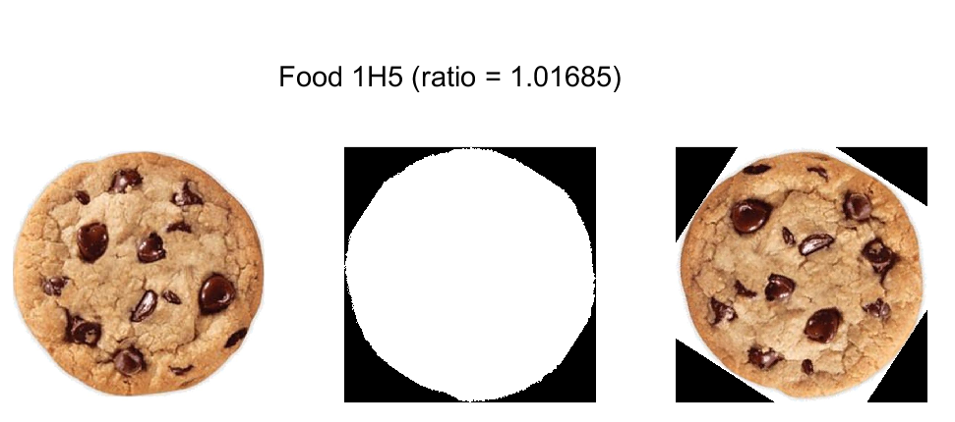
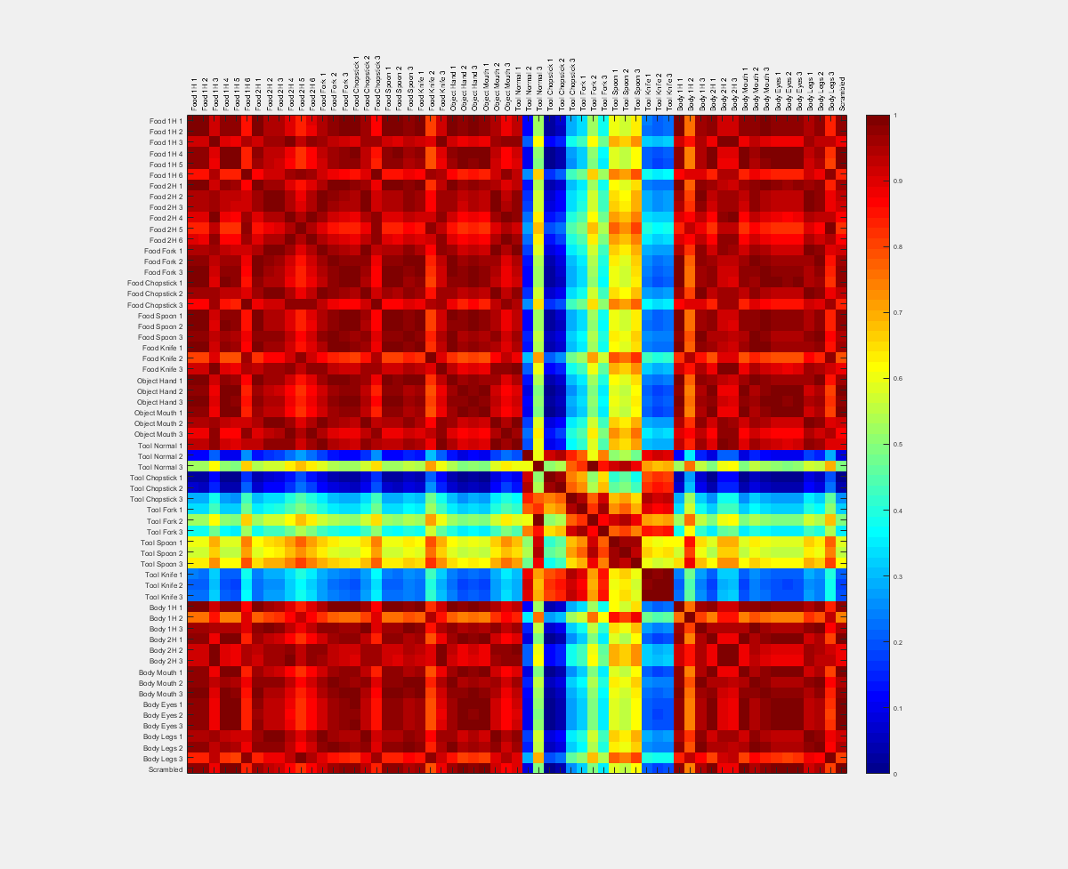
Elongation
Convert to binary (foreground vs background)
For each image, rotate up to 180º to find the angle that maximizes image height considering the foreground pixels only
By default, steps are 0.5º
Calculate the ratio of height to width at the optimal angle
Compute distance matrix
Invert for similarity

Slide 7
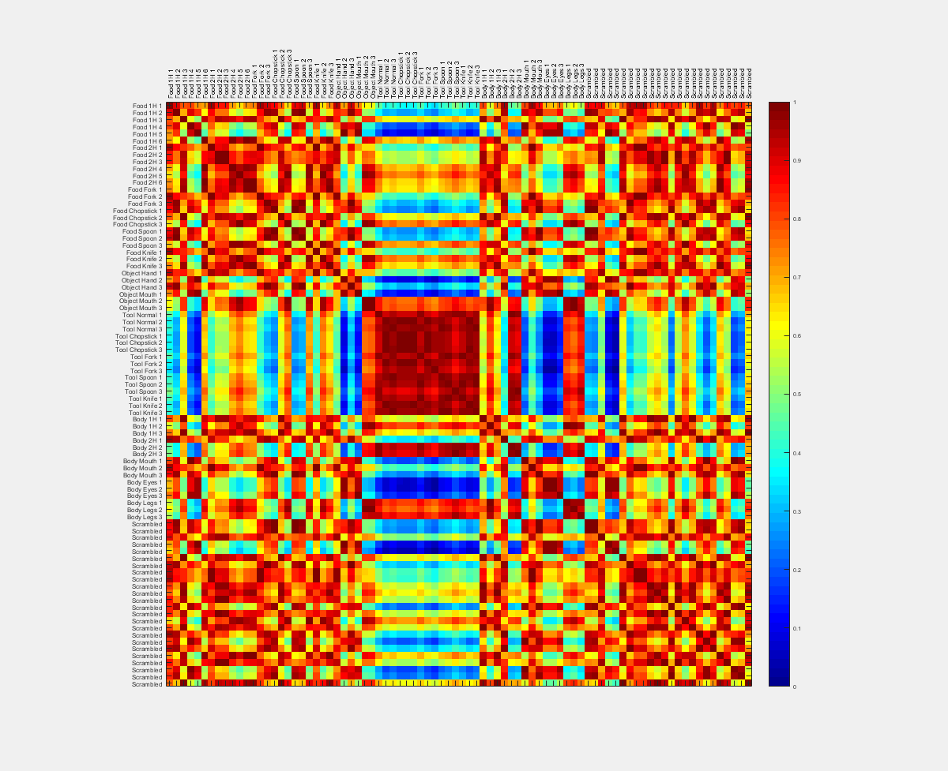
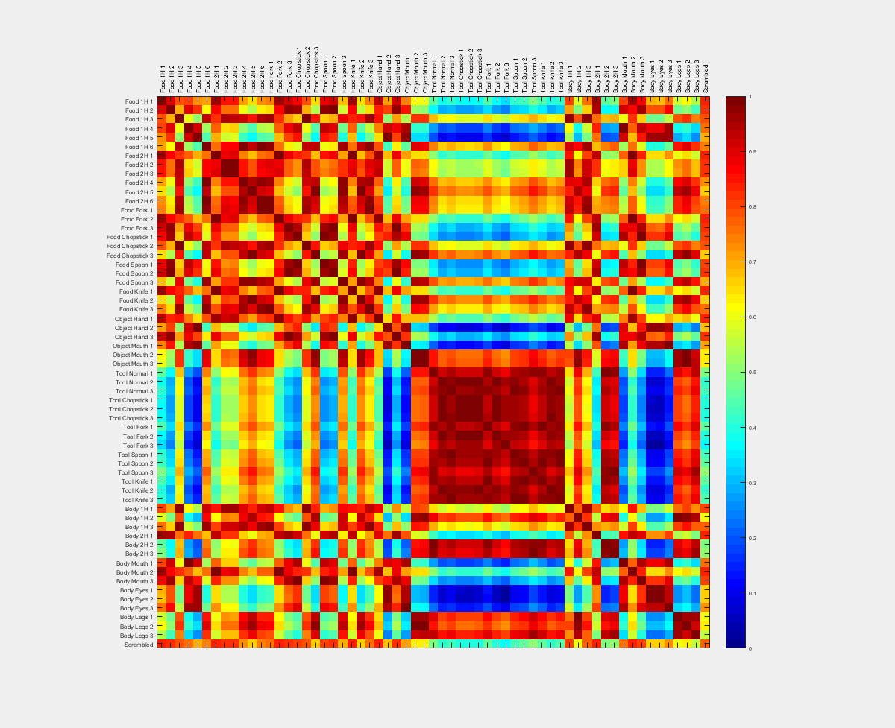
PixelCount
Convert to binary (foreground vs background)
For each image, count the number of foreground pixels (1 value per image)
Compute distance matrix
Invert for similarity

Slide 8
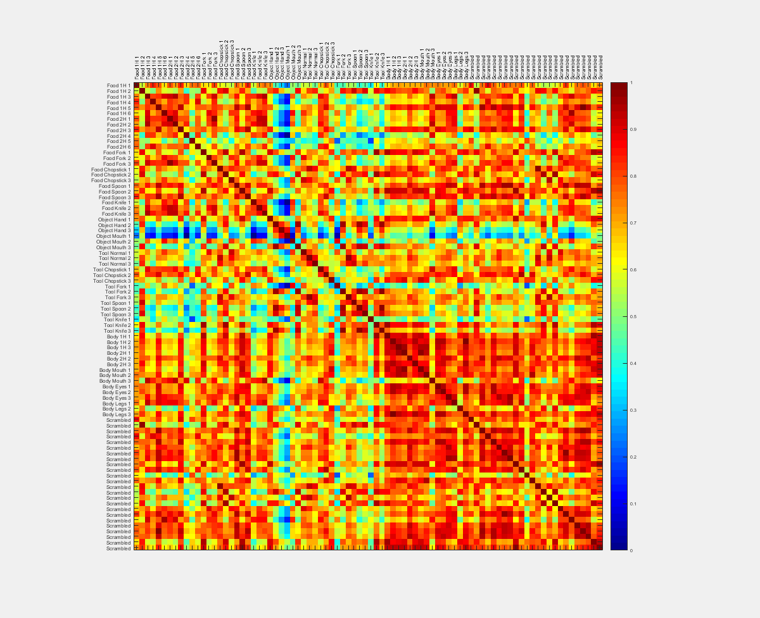
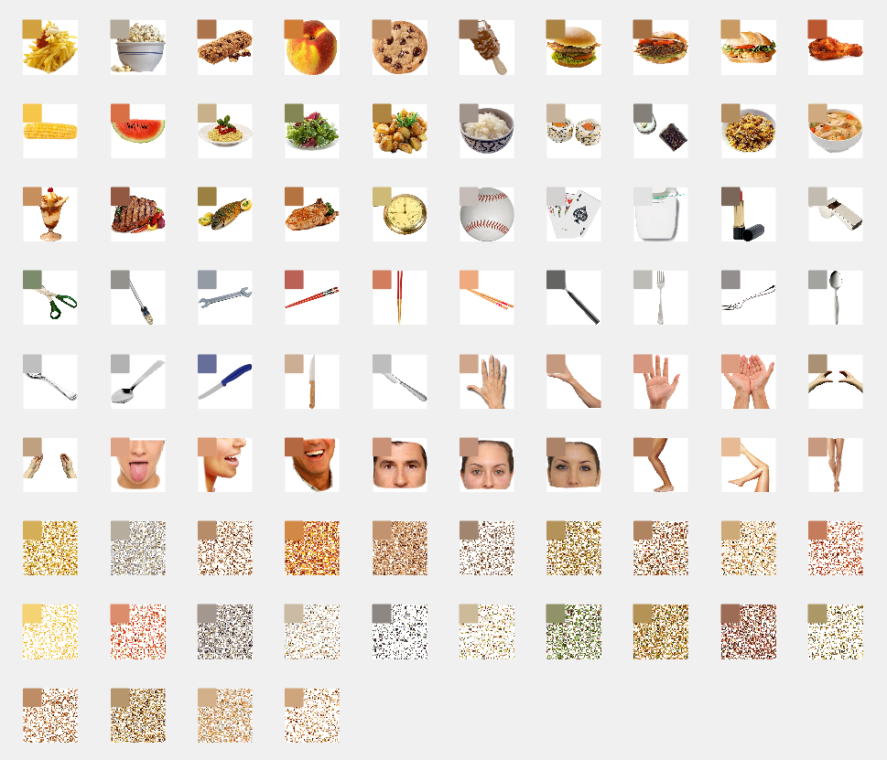
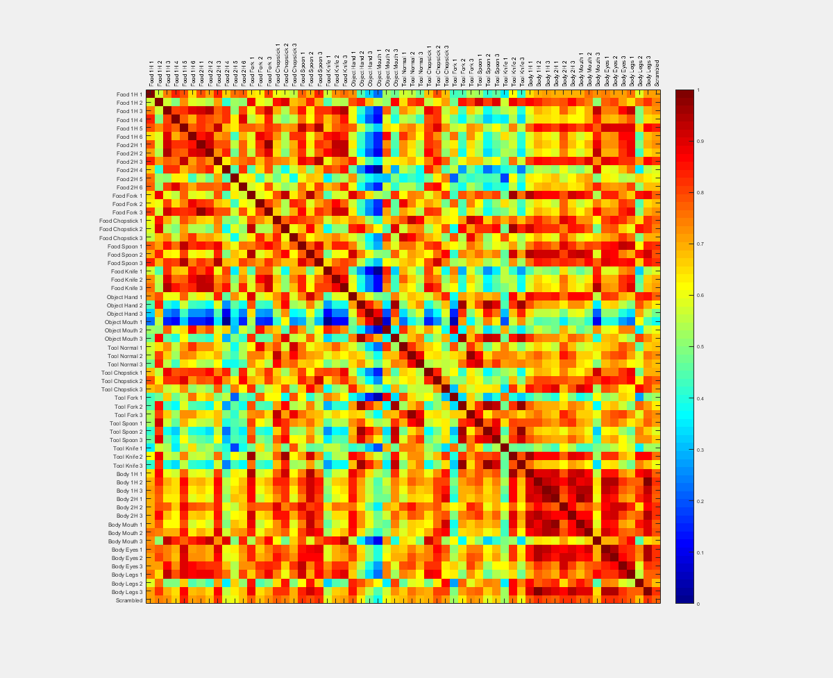
Colour Average
Find foreground pixels
Calculate average RGB of foreground pixels (1 colour per image)
Compute distance matrix (3-dimension point distances)
Invert for similarity

Slide 9
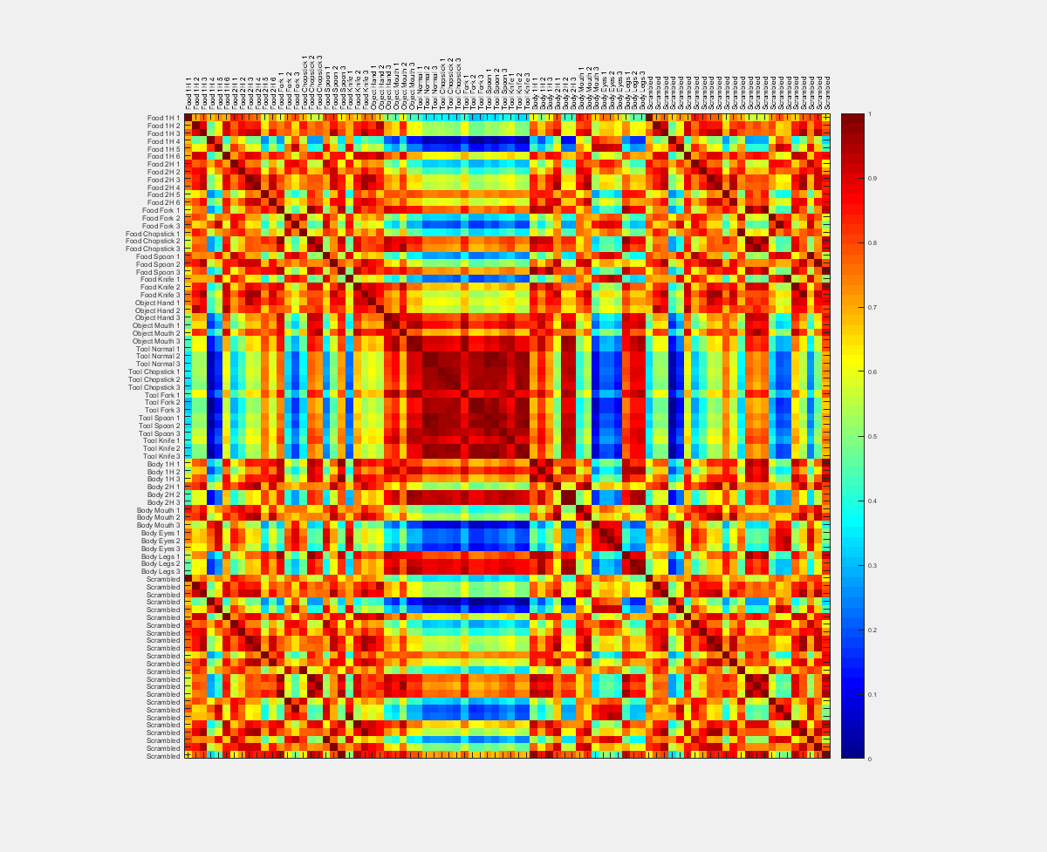
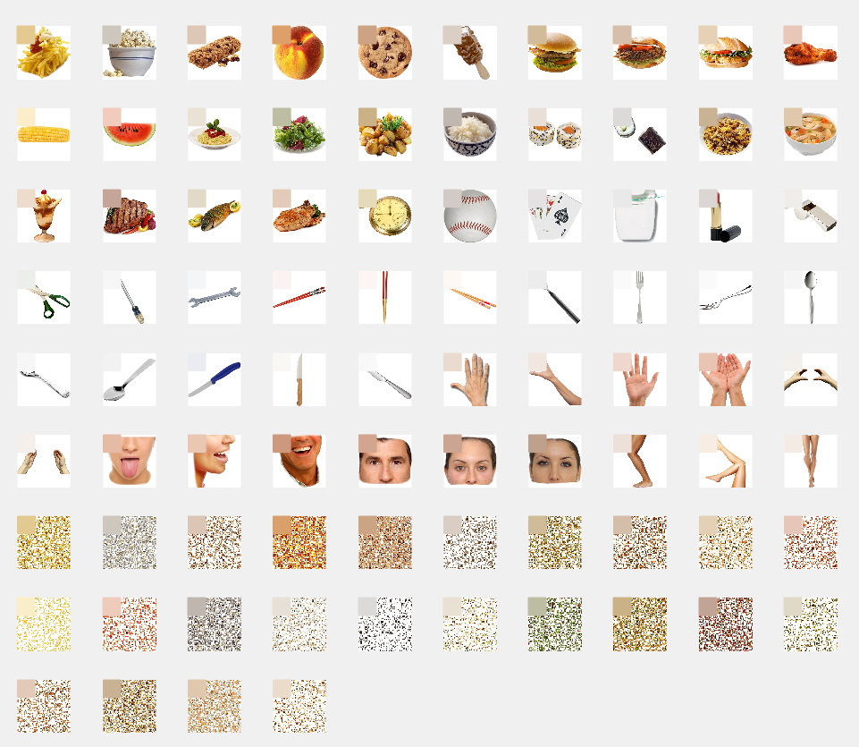
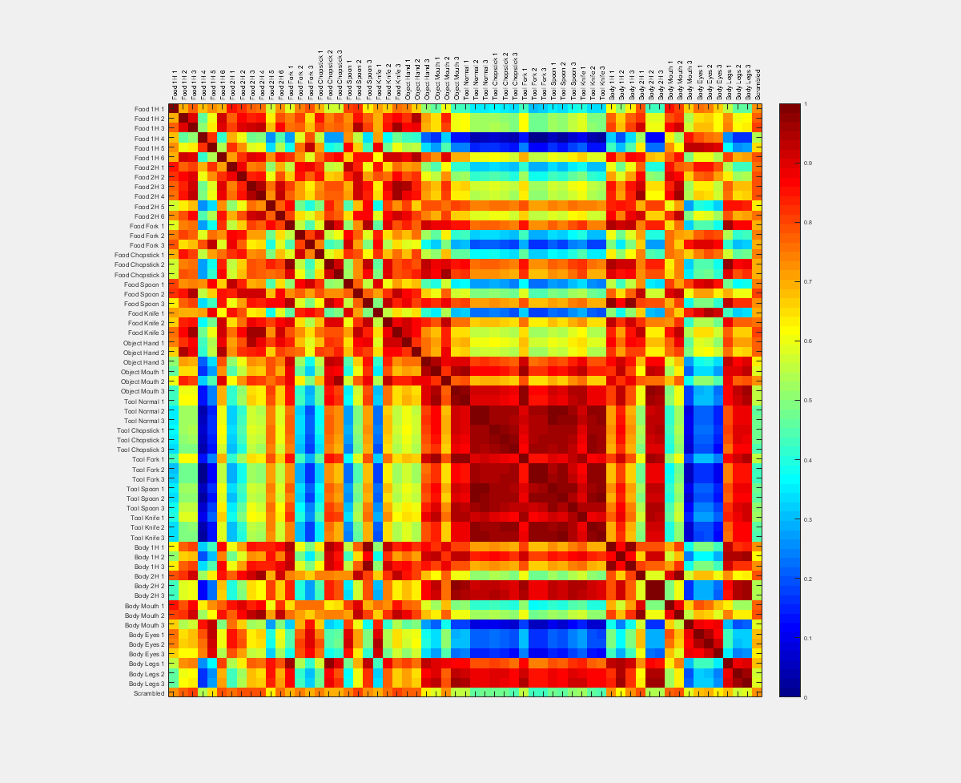
Colour Average (All)
Same as Colour Average, but uses all pixels (not just foreground)

Slide 10
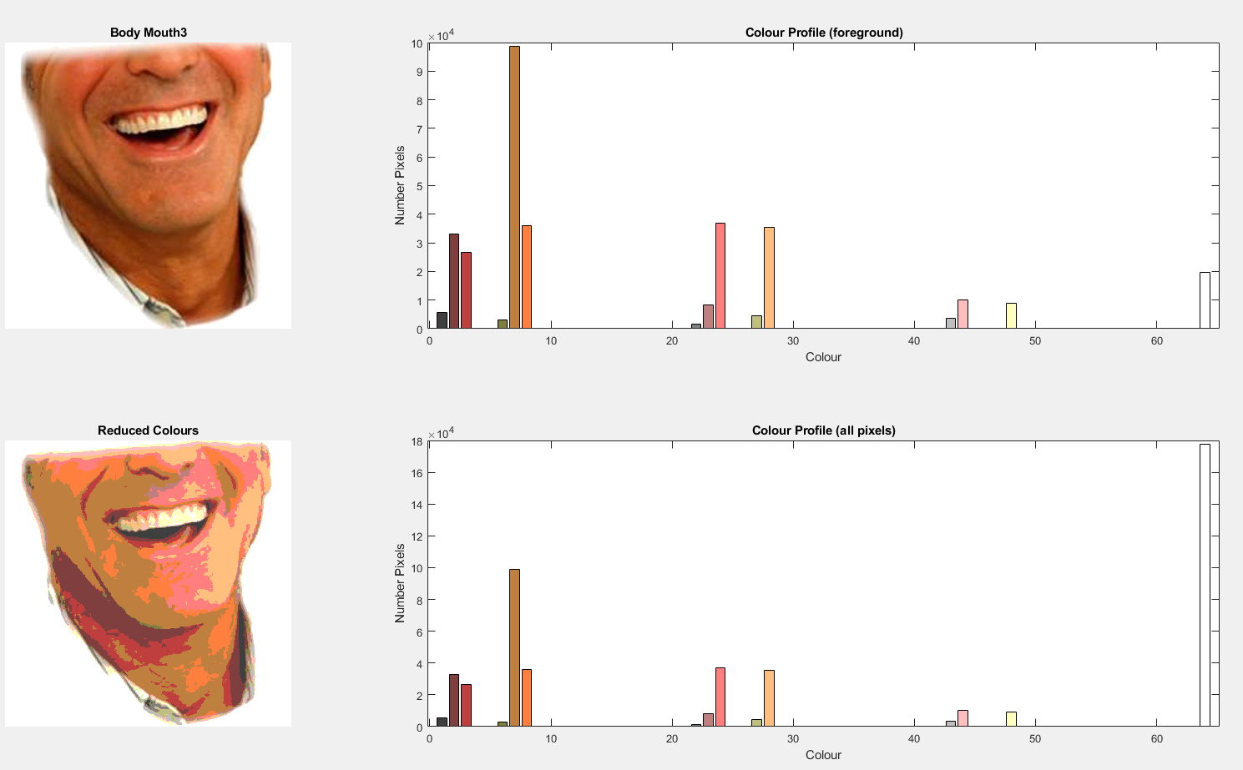
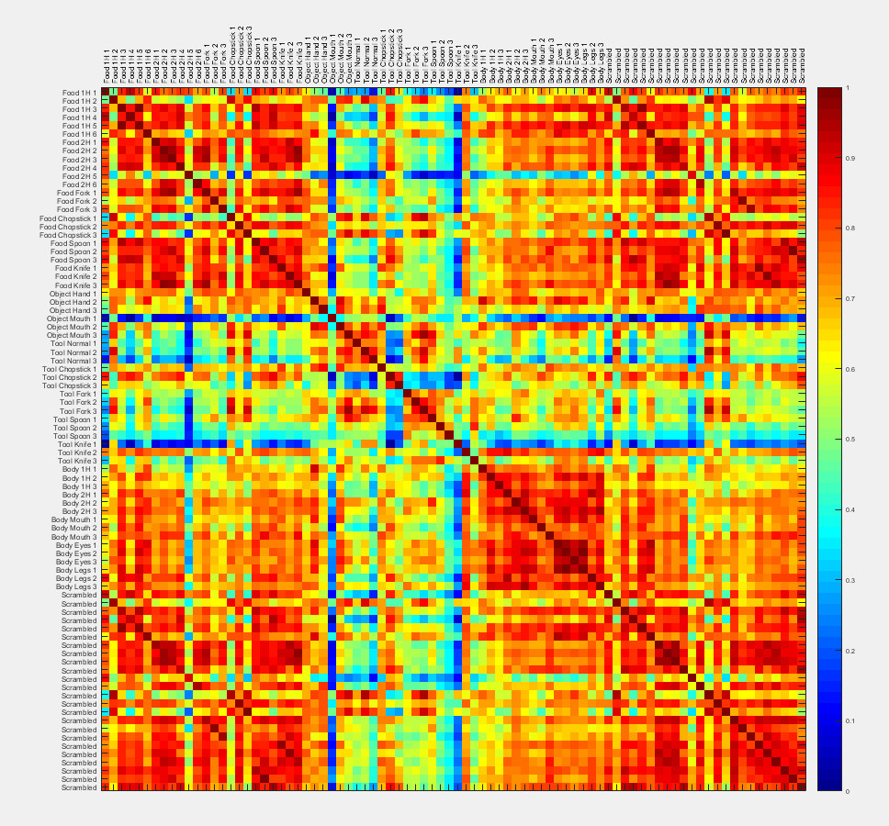
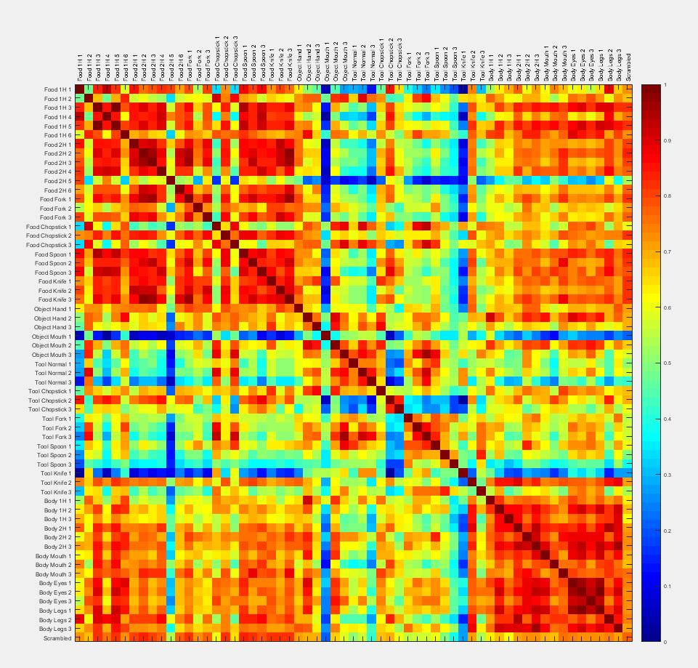
Colour Profile (foreground or all-pixels)
Reduce colour depth (default is 64 total colours, other options are 27 and 125)
Create colour profiles (number pixels per colour)
Correlate (Spearman) each pair of colour profiles
Foreground vs all-pixels makes very little difference.

Slide 11
Notes
Many models have been adjusted to have a range of 0-to-1 or -1 to +1
This does not affect data-model correlations, but can make for nicer figures
Silhouette and Luminance models exclude pixels that are not used by any image (i.e., pixels that are always background)
This shifts values in the correlation matrix equally so data-model correlations are not affected

